Slide 1
Software Engineering Fundamentals

Slide 2
Table of Contents
Software engineering overview
Requirements
Design
Construction
Testing
Project management
Software Solution Stack

Slide 3
Software Engineering
Requirements, Design, Construction, Testing

Slide 4


What is Software Engineering?
Software engineering is the application of a systematic, disciplined and quantifiable approach to the development, operation, and maintenance of software.
Definition by IEEE

Slide 5


Software Engineering
Software engineering is:
An engineering discipline that provides knowledge, processes, tools, and approaches for:
Defining software requirements
Performing software design
Software construction
Software testing
Software maintenance tasks
Software project management

Slide 6
Software Development Activities
Software development always includes the following activities (to some extent):
Requirements analysis
Design
Construction
Testing
These activities do not follow strictly one after another (depends on the methodology)!
Often overlap and interact
Software Project Management

Slide 7
Software Requirements
Functional & Non-Functional Requirements, Requirements Specification

Slide 8

Software Requirements
Software requirements describe the functionality of the software
Answer the question "what?", not "how?"
Define constraints on the system
Two kinds of requirements
Functional requirements
Non-functional requirements

Slide 9
Requirements Analysis
Requirements analysis starts from an idea about the system
Customers usually don't know what they need!
Requirements come roughly
Adjusted during the development
Requirements change constantly
The outcome is some requirements documentation
Software Requirements Specification (SRS) / User Stories / UI prototype / informal system description / etc.
Prototyping is often used, especially for the user interface (UI)

Slide 10

Software Requirements Specification (SRS)
The Software Requirements Specification (SRS) is a formal requirements document
SRS describes in details:
Functional requirements
Business processes
Actors and use-cases
Non-functional requirements
E.g. performance, scalability, hardware, integrations, constraints, security, etc.

Slide 11
Software Requirements
It is always hard to describe and document the requirements in comprehensive way
Good requirements save time and money
Requirements always change during the project!
Good requirements reduces the changes
UI prototypes significantly reduce changes

Slide 12
Software Architecture and Software Design

Slide 13

Software Architecture and Software Design
Software design is a technical description (blueprints) about how the system will implement the requirements
The system architecture describes:
How the system will be decomposed into subsystems (modules)
Responsibilities of each module
Interaction between the modules
Platforms and technologies

Slide 14
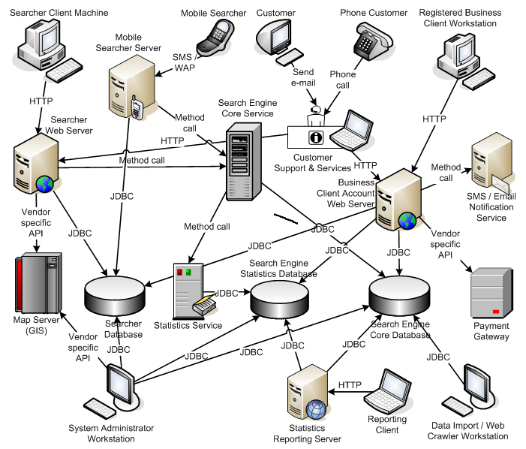
System Architecture Diagram – Example

Slide 15
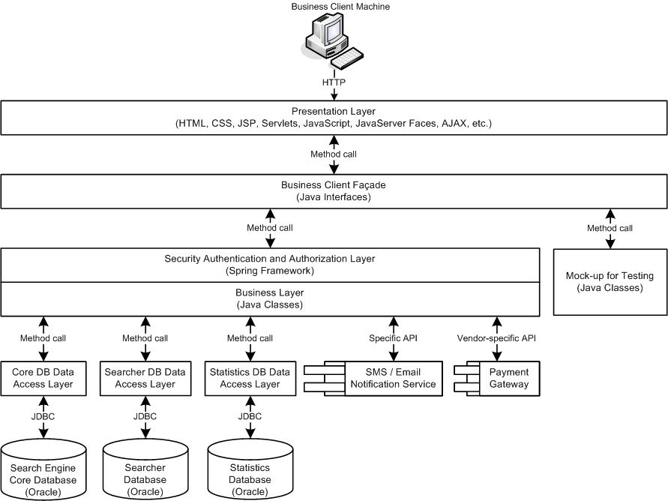
Software Architecture Diagram – Example

Slide 16
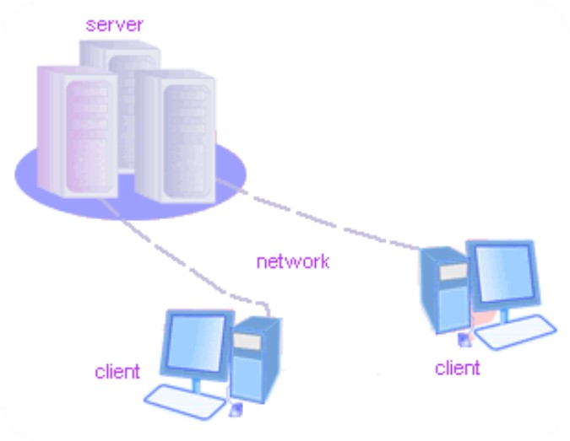
Client-Server Architecture

Slide 17
Client-Server Architecture
The client-server model consists of:
Server – a single machine / application that provides services to multiple clients
Could be IIS based Web server
Could be WCF based service
Could be a services in the cloud
Clients –software applications that provide UI (front-end) to access the services at the server
Could be WPF, HTML5, Silverlight, ASP.NET, …
17

Slide 18
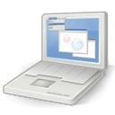
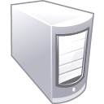


The Client-Server Model
Client Machine
network connection
network connection
Mobile Client
network connection
Server
Desktop Client
18

Slide 19
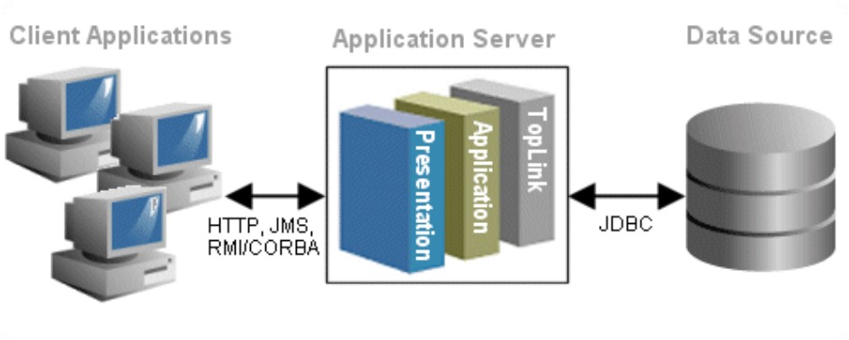
3-Tier / Multi-Tier Architectures

Slide 20
The 3-Tier Architecture
The 3-tier architecture consists of the following tiers (layers):
Front-end (client layer)
Client software – provides the UI of the system
Middle tier (business layer)
Server software – provides the core system logic
Implements the business processes / services
Back-end (data layer)
Manages the data of the system (database / cloud)
20

Slide 21


The 3-Tier Architecture Model
Data Tier (Back-End)
Middle Tier Client Tier (Front-End) (Business Tier)
Client Machine
network
network
Mobile Client
network
Database
Business Logic
Desktop Client
21

Slide 22



Typical Layers of the Middle Tier
The middle tier usually has parts related to the front-end, business logic and back-end:
Presentation Logic
Implements the UI of the application (HTML5, Silverlight, WPF, …)
Business Logic
Implements the core processes / services of the application
Data Access Logic
Implements the data access functionality (usually ORM framework)
22

Slide 23
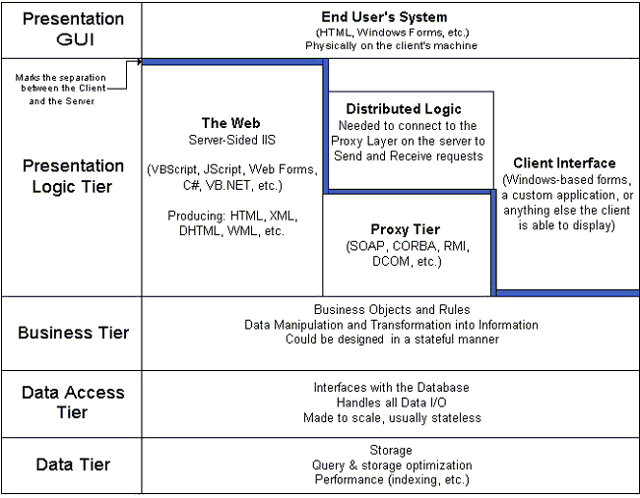
Multi-Tier Architecture
HTML
ASP
.NET
WCF
ORM DB
23

Slide 24
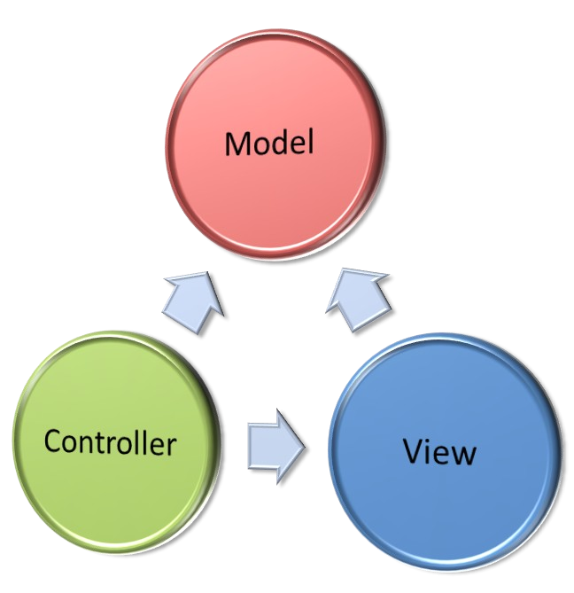
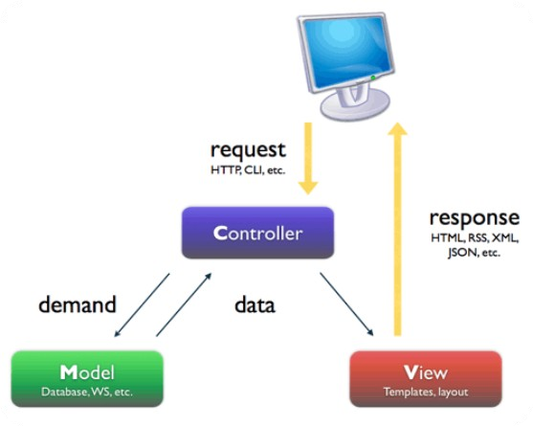
MVC (Model - View - Controller)

Slide 25
Model-View-Controller (MVC)
Model-View-Controller (MVC) architecture
Separates the business logic from application data and presentation
Model
Keeps the application state (data)
View
Displays the data to the user (shows UI)
Controller
Handles the interaction with the user
25

Slide 26
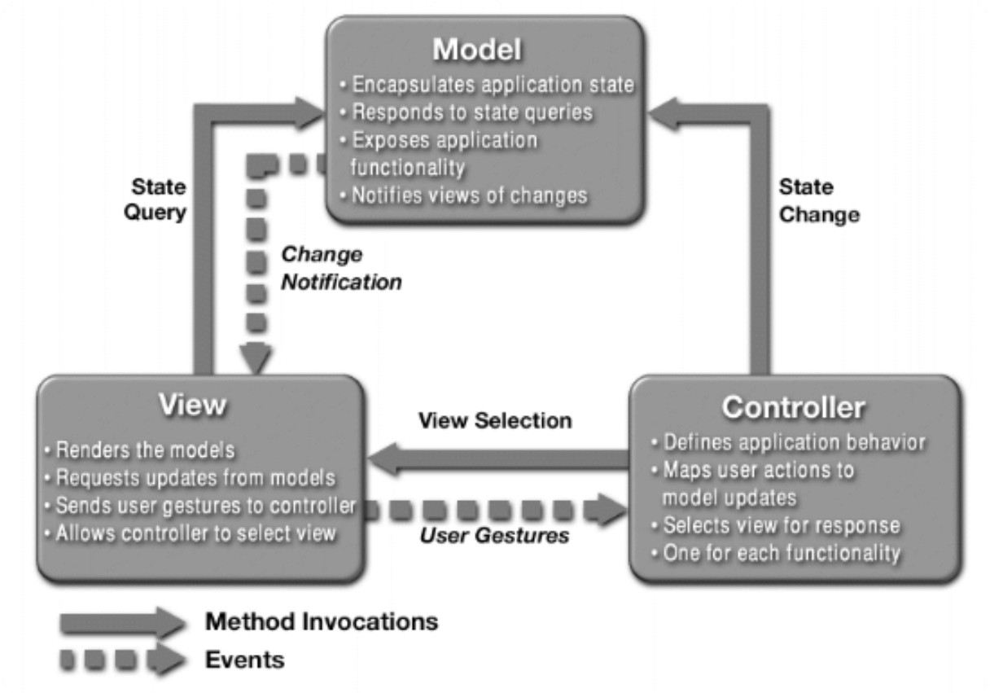
MVC Architecture Blueprint
26

Slide 27
MVC-Based Frameworks
.NET
ASP.NET MVC, MonoRail
Java
JavaServer Faces (JSF), Struts, Spring Web MVC, Tapestry, JBoss Seam, Swing
PHP
CakePHP, Symfony, Zend, Joomla, Yii, Mojavi
Python
Django, Zope Application Server, TurboGears
Ruby on Rails
27

Slide 28




MVC and Multi-Tier Architecture
Controllers (Business Logic)
Views (Presentation)
Model (Data)
Data Access Logic
28

Slide 29
Software Design
Detailed Design
Describes the internal module structure
Subcomponents, interfaces, process design, data design
Object-Oriented Design
Describes the classes, their responsibilities, relationships, dependencies, and interactions (usually in UML)
Internal Class Design
Methods, responsibilities, algorithms and interactions

Slide 30

Software Design Document (SDD)
The Software Design Document (SDD)
Formal description of the architecture and design of the system
SDD contains:
Architectural design
Modules and their interaction (diagram)
For each module
Process design (diagrams)
Data design (E/R diagram)
Interfaces design (class diagram)

Slide 31
Software Construction
Implementation, Unit Testing, Debugging, Integration

Slide 32

Software Construction
During the software construction phase developers build the software
Sometimes called implementation phase
Software construction includes:
Internal method design
Writing the source code
Writing the unit tests (optionally)
Testing and debugging
Integration

Slide 33

Writing the Code
Coding is the process of writing the programming code (the source code)
The code strictly follows the design
Developers perform internal method design as part of coding
The source code is the output of the software construction process
Written by developers
Can include unit tests

Slide 34
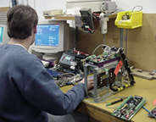

Testing the Code
Testing checks whether the developed software conforms to the requirements
Aims to identify defects (bugs)
Developers test the code after writing it
At least run it to see the results
Unit testing works better
Units tests are repeated many times
System testing is done by the QA engineers
Unit testing is done by developers

Slide 35
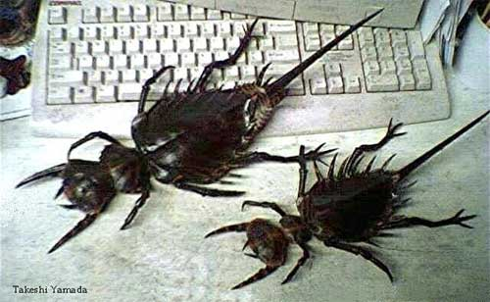
Debugging
Debugging aims to find the source of already identified defect and to fix it
Performed by developers
Steps in debugging:
Find the defect in the code
Identify the source of the problem
Identify the exact place in the code causing it
Fix the defect
Test to check if the fix is working correctly

Slide 36

Software Integration
Integration is putting all pieces together
Compile, run and deploy the modules as a single system
Test to identify defects
Integration strategies
Big bang, top-down and bottom-up
Continuous integration (CI)

Slide 37
Coding != Software Engineering
Inexperienced developers consider coding the core of development
In most projects coding is only 20% of the project activities!
The important decisions are taken during the requirements analysis and design
Documentation, testing, integration, maintenance, etc. are often disparaged
Software engineering is not just coding!
Programmer != software engineer

Slide 38
Software Verification and Testing

Slide 39

Software Verification
What is software verification?
Checks whether the developed software conforms to the requirements
Performed by the Quality Assurance Engineers (QA engineers)
Two approaches:
Formal reviews and inspections
Different kinds of testing
Cannot certify absence of defects!
Can only decrease their rates

Slide 40
Software Testing
Testing checks whether the developed software conforms to the requirements
Testing aims to find defects (bugs)
Black-box and white-box tests
Unit tests, integration tests, system tests, acceptance tests
Stress tests, load tests, regression tests
Tester engineers can use automated test tools to record and execute tests

Slide 41

Software Testing Process
Test planning
Establish test strategy and test plan
During requirements and design phases
Test development
Test procedures, test scenarios, test cases, test scripts
Test execution
Test reporting
Retesting the defects

Slide 42
Test Plan and Test Cases
The test plan is a formal document that describes how tests will be performed
List of test activities to be performed to ensure meeting the requirements
Features to be tested, testing approach, schedule, acceptance criteria
Test scenarios and test cases
Test scenarios – stories to be tested
Test cases – tests of single function

Slide 43
Software Project Management

Slide 44
What is Project Management?
Project management is the discipline of
Organizing and managing work and resources in order to successfully complete a project
Successfully means within defined scope, quality, time and cost constraints
Project constraints:
Scope
Quality
Cost
Time

Slide 45
What is Software Project Management?
Software project management
Management discipline about planning, monitoring and controlling software projects
Project planning
Identify the scope, estimate the work involved, and create a project schedule
Project monitoring and control
Keep the team up to date on the project's progress and handle problems

Slide 46
What is Project Plan?
The project plan is a document that describes how the work on the project will be organized
Contains tasks, resources, schedule, milestones, etc.
Tasks have start, end, assigned resources (team members), % complete, dependencies, nested tasks, cost, etc.
Project management tools simplify creating and monitoring project plans

Slide 47
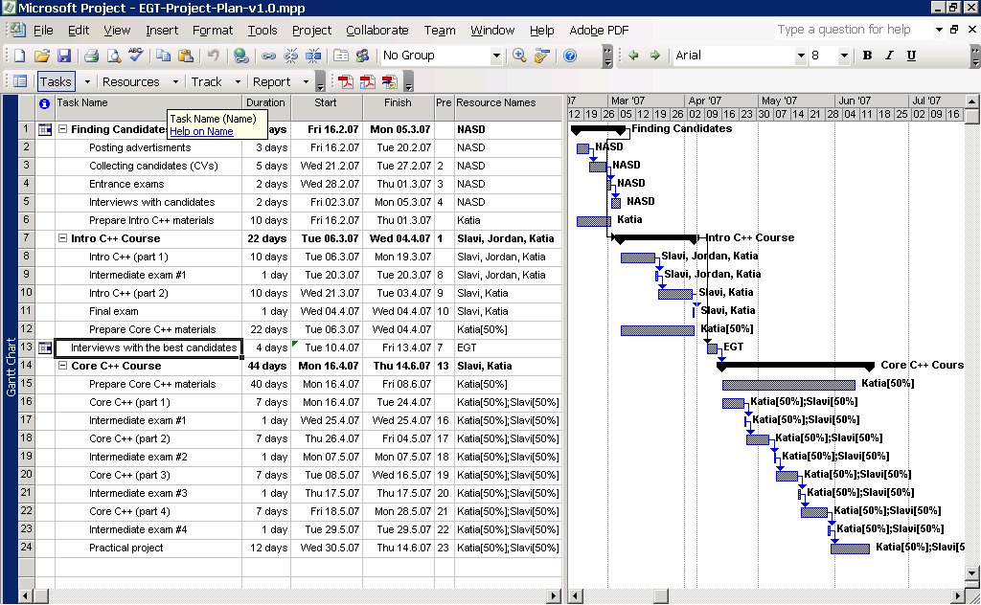
Project Plan – Example

Slide 48
Software Solution stacks

Slide 49

Web 1.0
Static pages of hyperlinked information
Information revolution
created using HTML
<mark-up language>
HTML
HTML
HTML

Slide 50
Client/Server Request/Response
Web Browser The Internet
Web Server
at server.com
Disk Drive
at server.com
User requests
http://server.com
Look up address of:
server.com
Request server.com main page using IP
Receive request for index page
Fetch index.html from hard disk
Return the index page
Receive and display page

Slide 51
Moving Forward
Look and feel improved with style sheets
presentation and style could be separated from the information structure and content Cascading Style Sheet (CSS) Mixed Media
CSS
HTML
Video
Audio
Image

Slide 52


Dynamic Content
Server side dynamic content generation
Mature Web Server Stacks (e.g. LAMP)
Sites became web services (data not pages)
PHP Script
Database
Request Web Page
Web Server
Template Engine
HTML

Slide 53
Dynamic request/response
Web Server Disk Drive
PHP Processor
mySQL Database
Receive Request
Fetch Page
Contains PHP?
Process PHP
Execute SQL
Receive Data
Return Page

Slide 54
Client/Server Request/Response
Web Browser
The Internet
PHP
Processor
Web Server
at server.com
Disk Drive
at
server.com
mySQL Database
User requests
http://server.com
Look up address of:
server.com
Request server.com main page using IP
Receive request
for index page
Fetch index.html from hard disk
Contains PHP?
Process PHP
Execute SQL
Receive Data
Receive and display page
Return page

Slide 55
Why are web apps important?
Nobody wants simple web pages anymore
Desktop software for common tasks may be coming extinct
Oﬀsite storage as standard
Collaboration easily added
No software installation
No software updates

Slide 56
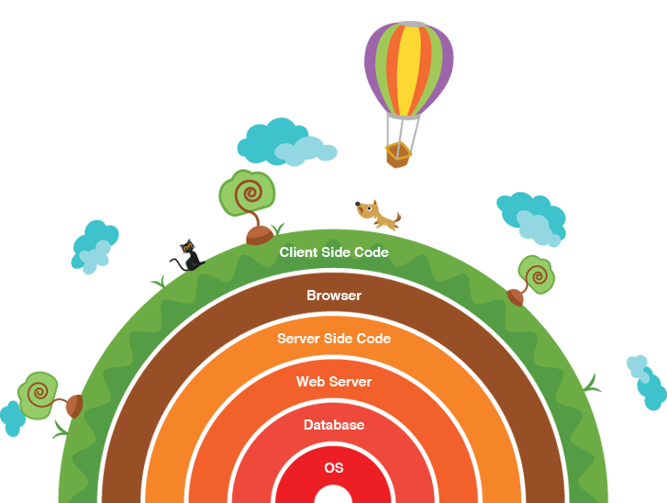
A software (or solution) stack: a set of components required to make a complete platform
Web stack: server side code utilizes web server and database all running on an operating system

Slide 57
Common Web Stacks
LAMP
Linux Apache MySQL PHP
WAMP
Windows Apache MySQL PHP

Slide 58
Common Web Stacks
LEMP | WIMP | WINS
Linux | Windows | Windows
EnginX | ISS | ISS
MySQL | MySQL | .Net
PHP | PHP | Sql Server

Slide 59
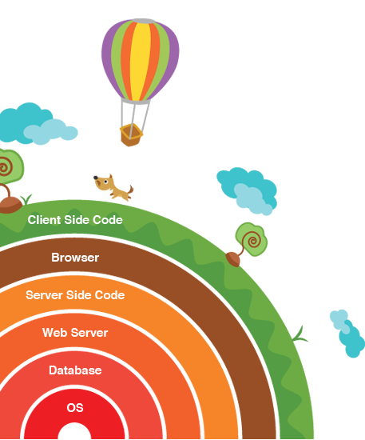
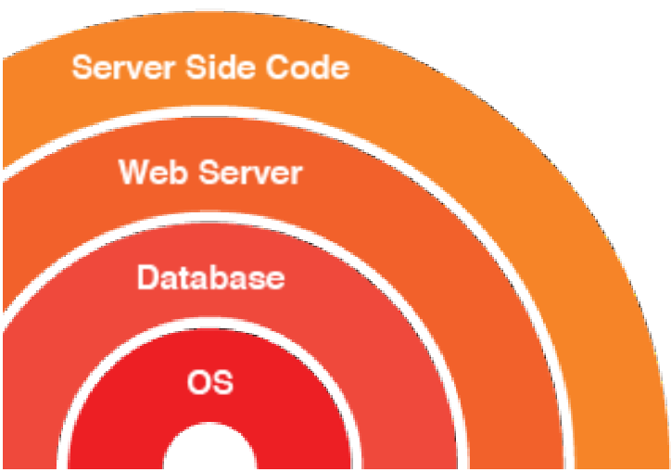
Linux Apache MySQL PHP

Slide 60
PHP
Apache MySQL
Linux

Slide 61


















Alternatives Exist…

Slide 62
LAMP
MEAN
no need to mention, node is cross platform
OS
Linux
Database
mySQL
mongoDB
node is its own server, Express makes it easier
nodeJS applications, may link to Angular clientside
HTTP Server
apache
Serverside Code
PHP

Slide 63
html
css php mySQL
How to structure a webpage
How to style a webpage
How to make a web page interactive
How to load and save information from a web page

Slide 64
Can be created and viewed on your own machine quite easily
html
css
How to structure a webpage
How to style a webpage
php
mySQL
How to make a web page interactive
How to load and save information from a web page
Needs specialised server in order to work

